Slide 1
IDENTIFICATION OF FISH SPECIES

Slide 2
OVERVIEW
Introduction
Domain
Contribution
Modules
Architectural Explanation
Result and Discussion
Output
Conclusion
References

Slide 3
INTRODUCTION
The ocean is full of mystery and the underwater exploration has always been an exciting topic. Nowadays, robotics has been widely adopted into our daily lives.
Identifying fish by their characteristics is crucial to many industries.
Manual methods to identify fish can be problematic they can be time-consuming, they may require large sampling efforts, sampling can be destructive to the marine environment.
Automated systems can help accurately classify these fish consistently.

Slide 4
DOMAIN
Deep Learning based tool for image-based identification of fish-species found in the water resource is to be developed.
For creating an application fisher need to take a photo of fishes caught and fish identification will be done automatically after classifying it based on the size, minimizing the manual intervention.
This species classifying application is planned to be developed using Convolution Neural Networks (CNN) to achieve maximum accuracy.

Slide 5
PROBLEM STATEMENT
This project is based on identification of the fish species.
In order to develop species-specific advisories, it is necessary to collect the fish- catch information to be categorized at some authentic level with an enhanced accuracy.
Often species level catch reporting is having technical hindrances due to several reasons pertaining to manual efforts, one among them would be ignorance about particular species in specific which results to low reporting.

Slide 6
CONTRIBUTION
The contribution of fish species prediction model is mainly used for predicting the type and kind of species is this related with the data.
Actually the primary vision of creating this project is to find the correct category
of fish, which can be done by analyzing the features of them.

Slide 7
MODULES
Loading the dataset
The Load method makes all these scenarios possible. This method allows you to specify a load option parameter, indicating how rows already in a DataTable combine with rows being loaded.
Data pre processing
Data preprocessing is a process of preparing the raw data and making it suitable for a machine learning model
Building the model
In this process the dataset which was loaded split into training and testing dataset. Then suitable algorithm is selected and it was for into a model .

Slide 8
Training the model
A training model is a dataset that is used to train an ML algorithm. It consists of the sample output data and the corresponding sets of input data that have an influence on the output.
Testing the model
Model testing is referred to as the process where the performance of a fully trained model is evaluated on a testing set.
Using our model to make predictions
Models are designed to analyze past data and make predictions about the future, such as models of seismic activity to predict future earthquakes.

Slide 9
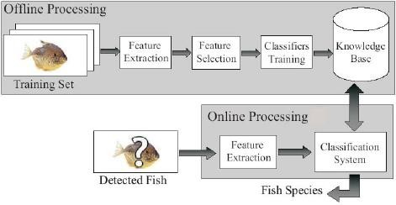

Slide 10
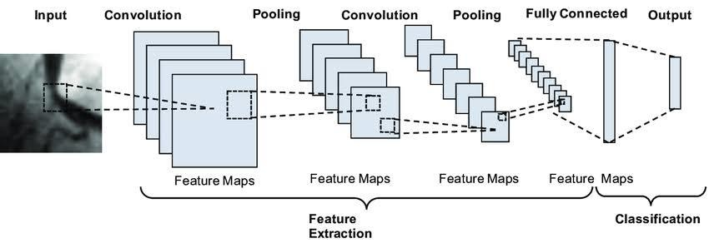
ARCHITECTURAL EXPLANATION

Slide 11
RESULT AND DISCUSSION
we have shown that a convolutional neural network is a useful method to classify fish images by species accurately.
These networks can be modified and scaled with relative ease.
We are optimistic about the transferability of this model to other real-world datasets and the potential of using it for high level classification of fish

Slide 12
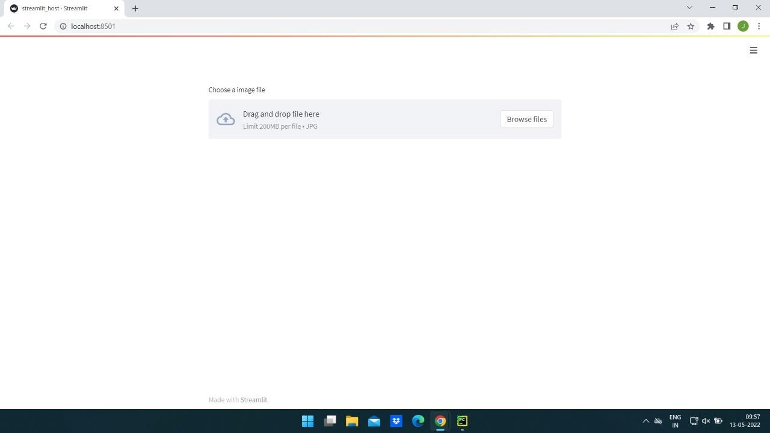
OUTPUT
Streamlit Host Page

Slide 13
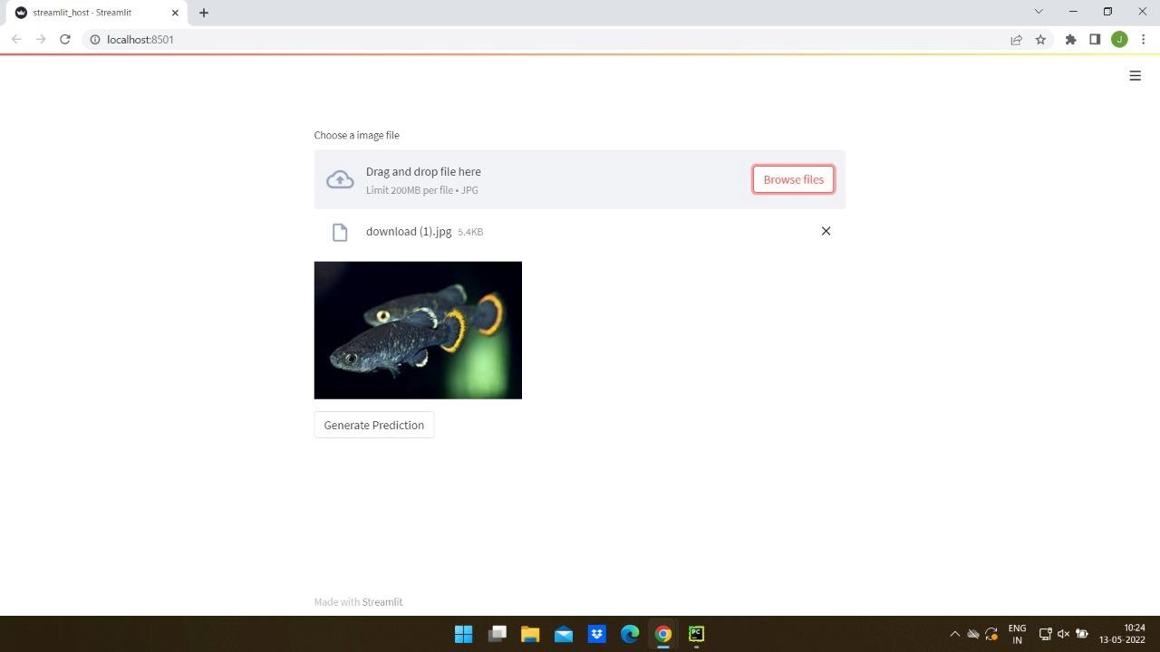
Prediction Page

Slide 14
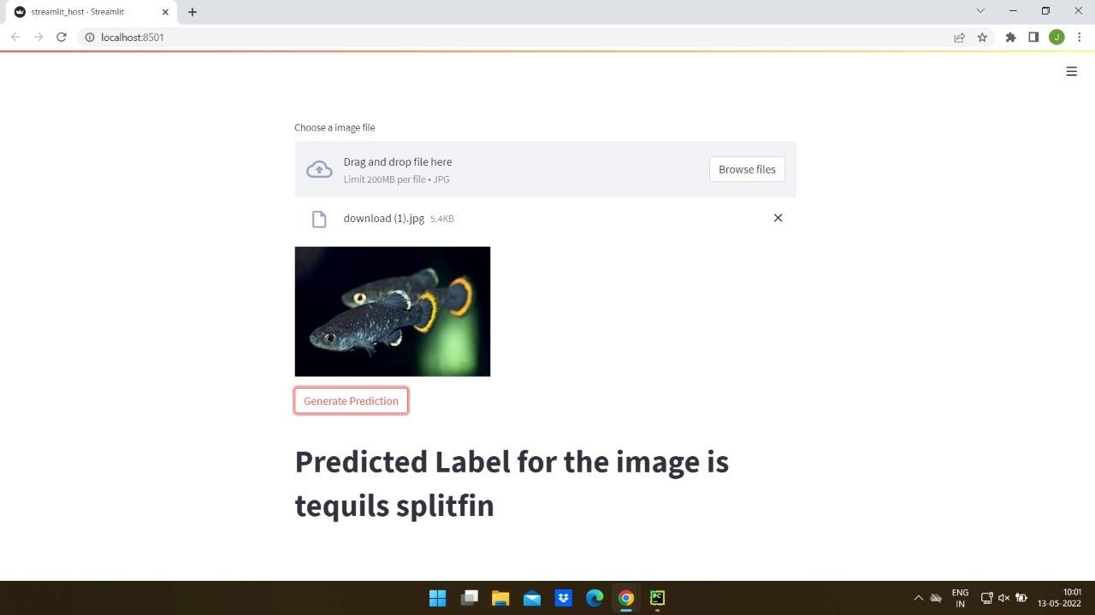

Slide 15
CONCLUSION
Our model performed well on the testing data. With an accuracy of 94.25%, the results are promising that this model could be used in the future for fish species identification and classification.
This makes it an ideal method for the entirety of the fishing and fisheries community as it proves to be accessible, cost-effective, and reliable means to fish classification.

Slide 16



Slide 17




ANY QUESTIONS ???

